Slide 1




Page 01
SUSTAIN INDIA
Gamifying India’s path to sustainability
India 2030: A Greener Future Awaits

Slide 2


Page 02
THE PROBLEM
Main Challenges:
25%+ water lost annually to inefficient farming
Rising carbon emissions with low personal accountability
Sustainability programs = low engagement, limited reach
By 2030, India’s water demand will be 2× the available supply.

Slide 3


THE SOLUTION
Page 03
A gamified national platform that makes sustainability fun, measurable, and rewarding.
Our solution is SustainIndia — a single app that combines AI, live data, and gamification to create a nationwide movement. Farmers can optimize water and fertilizer usage with Krishi AI. Citizens can track and lower their carbon footprint with EcoMeter. A national leaderboard sparks friendly competition between states. And our reward system turns sustainability into something you want to keep doing.

Slide 4
Page 04
HOW IT WORKS
Join & log activities
Earn EcoPoints for actions
1.
3.
Compete on leaderboards & challenges
AI recommends improvements
2.
4.

Slide 5

Page 05
KEY FEATURES
Real-time India map with state rankings
AI-driven tips for farming & carbon reduction
Gamification: badges, streaks, challenges
Rewards: certificates, shareable achievements

Slide 6

Page 06
TECHNOLOGY STACK
Frontend: Next.js, TailwindCSS, Framer Motion
Backend: Node.js + Express
Database: Supabase (PostgreSQL)
AI: OpenAI API
Charts: Chart.js, D3.js
Deployment: Vercel (frontend), Railway (backend)

Slide 7
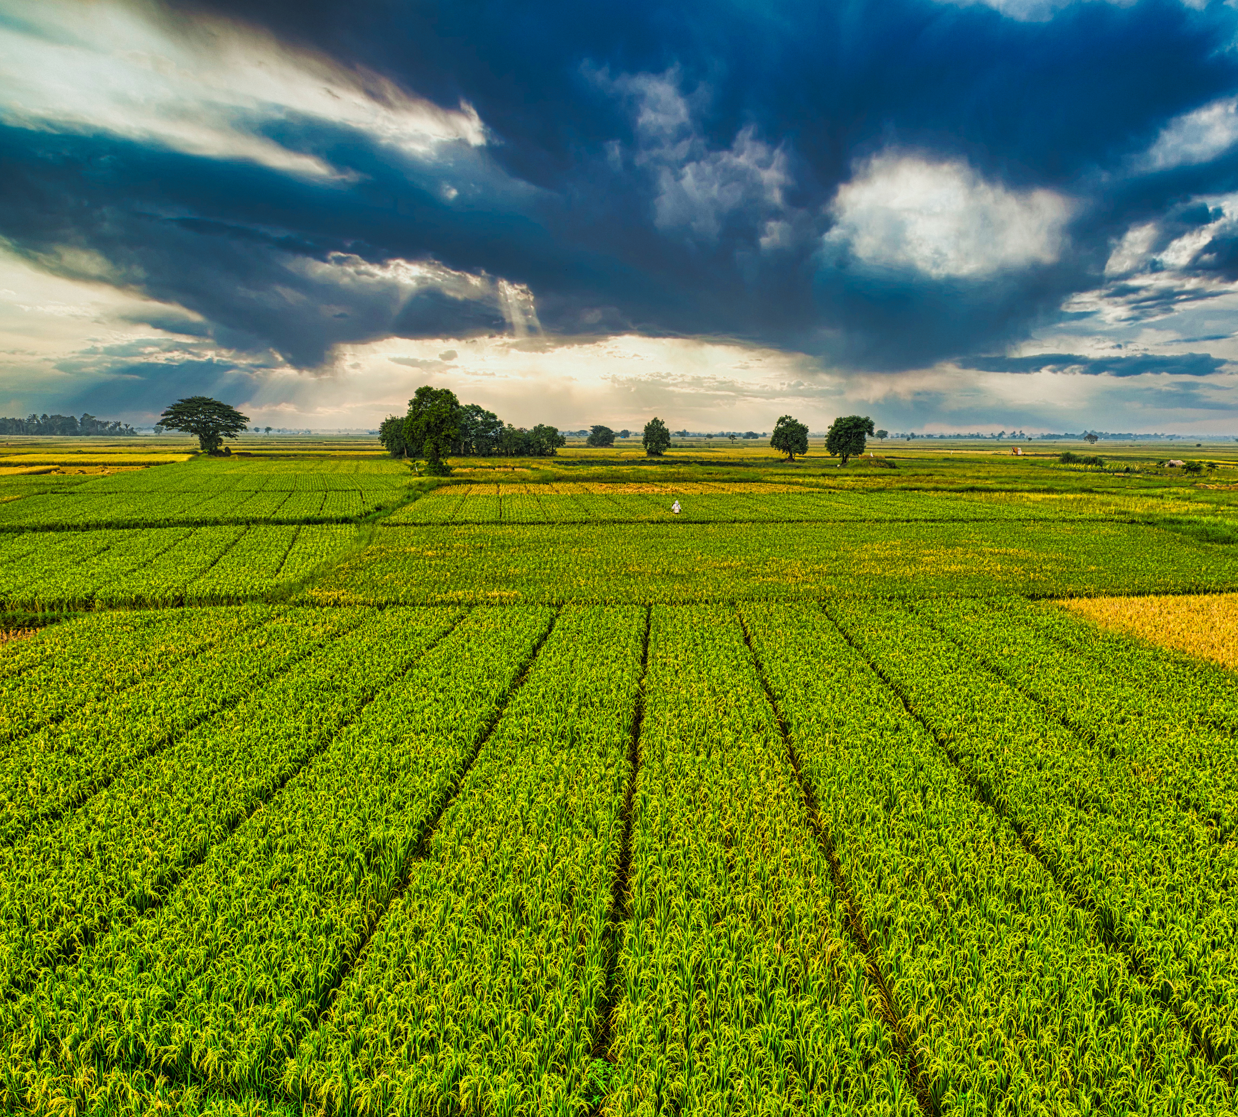

Page 07
IMPACT
For Farmers: Save water, increase yield
For Citizens: Reduce carbon footprint
For Nation: Real-time progress tracking
30% water saved per farmer/year
4 billion tons CO₂ avoided nationally

Slide 8


Page 08
PROTOTYPE
View Prototype by visiting our Github Repositories —

Slide 9


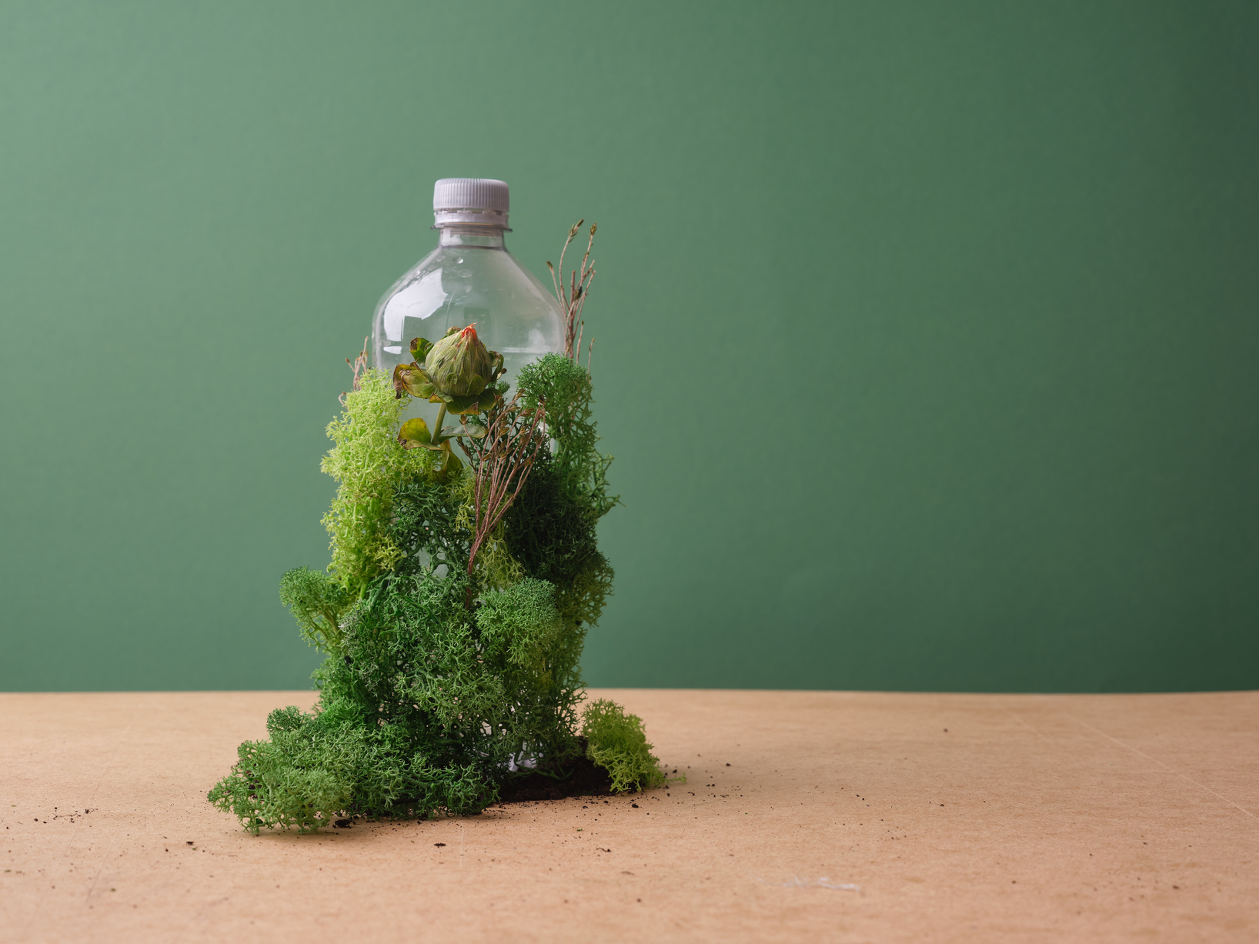

Page 09
FUTURE SCOPE
IoT integration for real-time data
AI chatbot for instant advice
Government partnerships for policy impact
Leaderboards for schools & colleges

Slide 10

Page 10
CONCLUSION
Together, we can make India greener — one point at a time.”
Call to Action: Join the Mission

Slide 11

Page 11
THANK YOU!
Together, we can create a greener and more sustainable future. Thank you for your commitment to protecting our planet.

